Slide 1


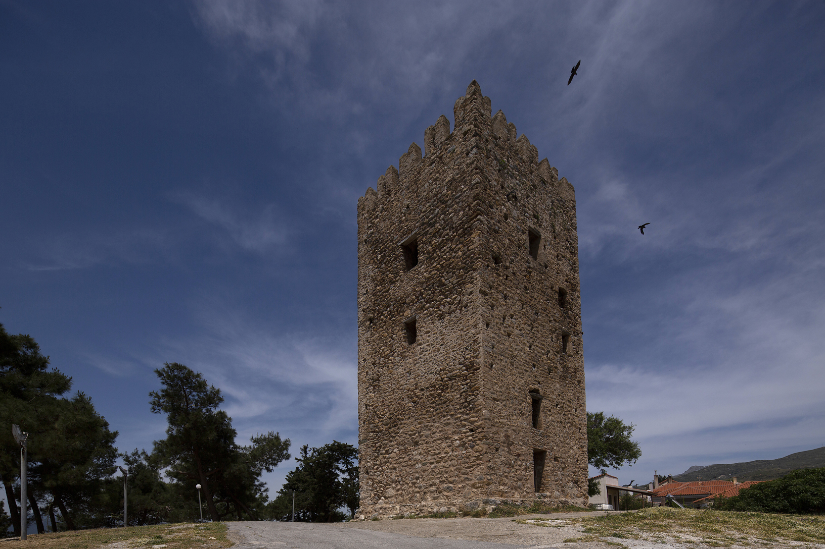
LIGHT MORE LIGHT
Friedrich Heinlderlin's translation of Sophocles' Antigone
9th European Student Conference Munich 26/11/2024-2/12/2024
Ενετικός Πύργος Αυλωναρίου.

Slide 2
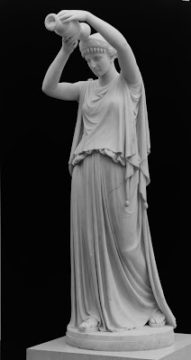
APPROACHES TO ANTIGONE
Translated in the 16th century From the 1800s many scholars interpreted this work and gave their own version more or less respecting the original. According to Schelling, the work of Sophocles is: "the real pinnacle of dramatic art". Hölderlin's translation is one of the masterpieces of modern philology. In 1948, Brecht staged Antigone using Gelderlin's text.

Slide 3
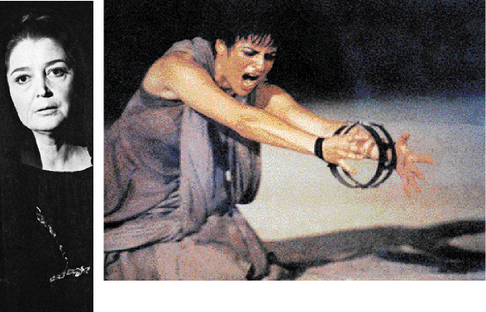
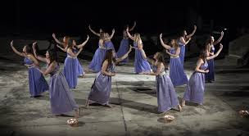

Slide 4
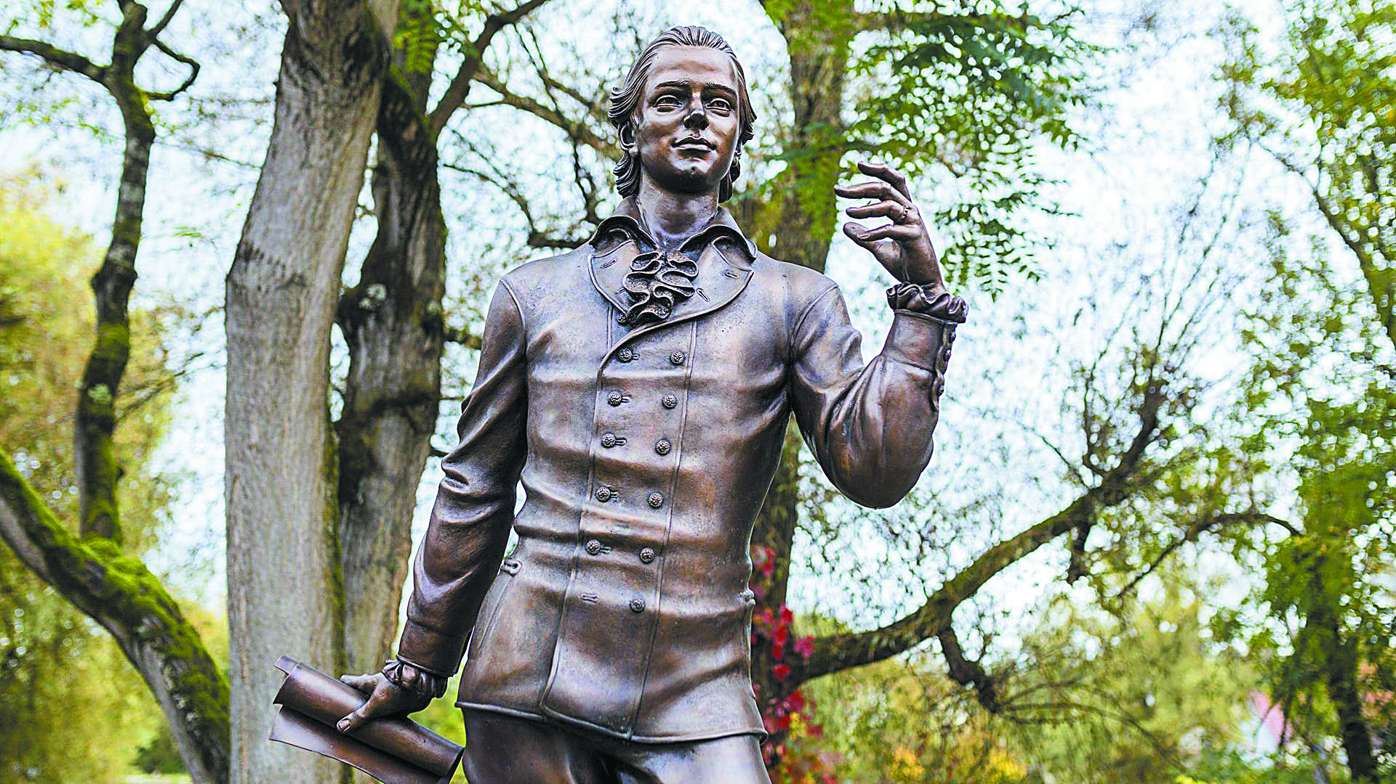
Yohan Creistian Friedrich Hilderlin(Johann Christian Friedrich Hölderlin (1770 -1843)
German lyric poet
Born in Lauffen, his work bridges the classical school in literature with the romantic.
Sculpture of the poet Friedrich Hölderlin (by Waldemar Schröder) in Nürtingen

Slide 5
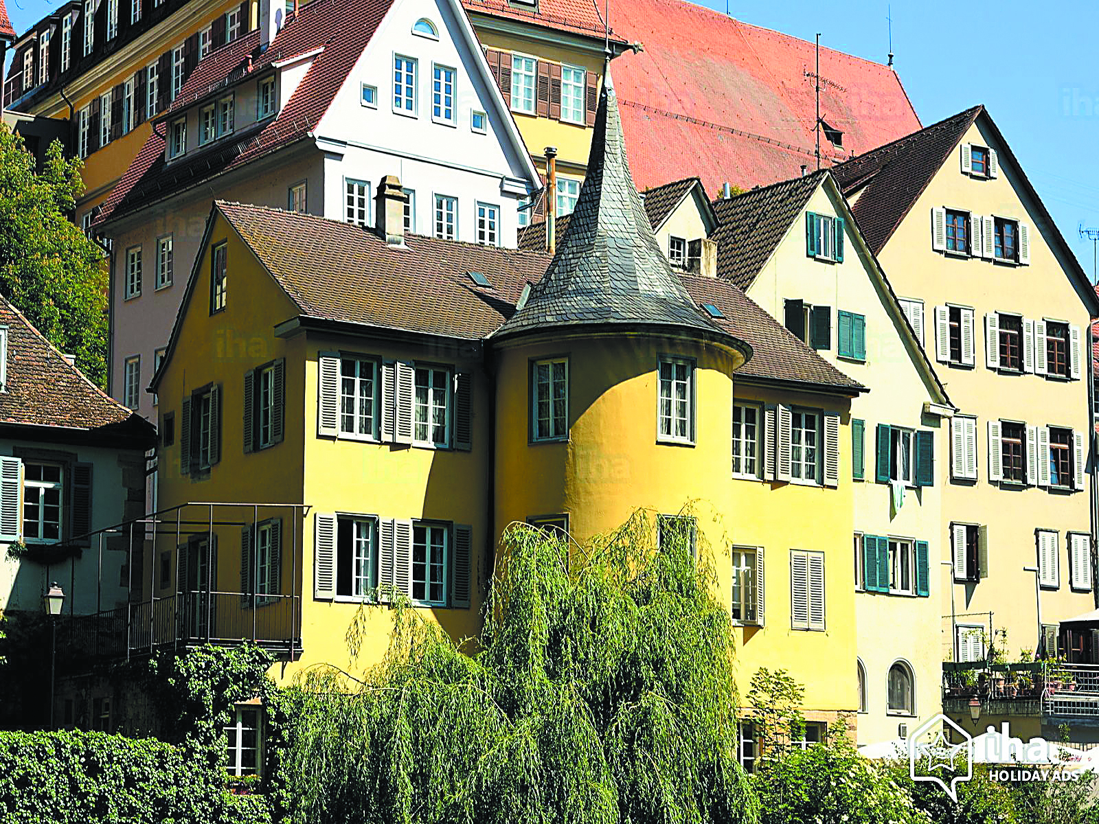
The poet in Tübingen
He studied Theology With his epistolary novel "Hyperion", he is the first European to support Greek independence. Meet Hegel Friedrich Schiller helped him in his career.
Hilderlin's tower in Tübingen

Slide 6
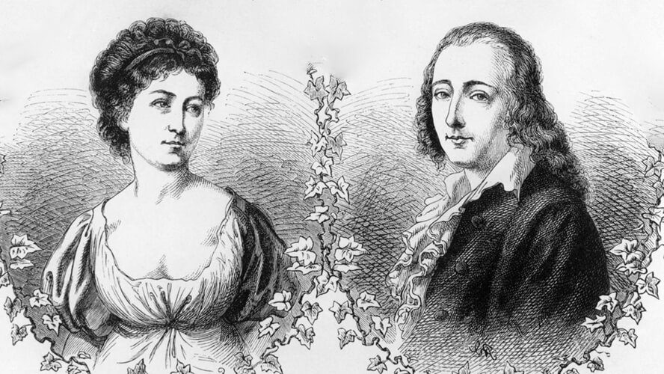
LOVE AND BLINDNESS
1796: met Suzette Goddard, symbol of his secret love. Hyperion gives her the nickname Diotima (the well-known priestess in the Platonic Symposium). Her death in 1802 would shake his mental health. In 1806 he was transferred to a phrenological clinic in Tübingen. Ernst Zimmer cared for him at home until his death in 1843.

Slide 7
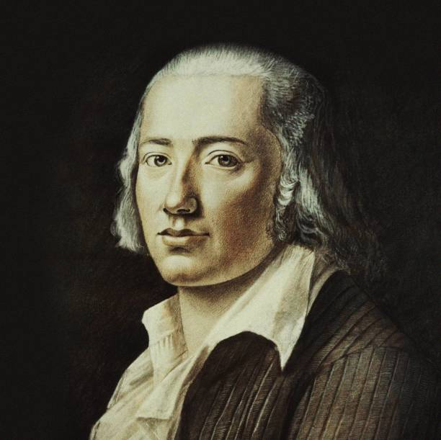
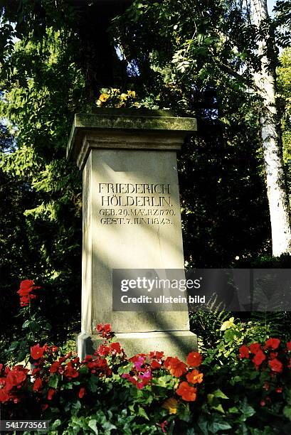

Slide 8
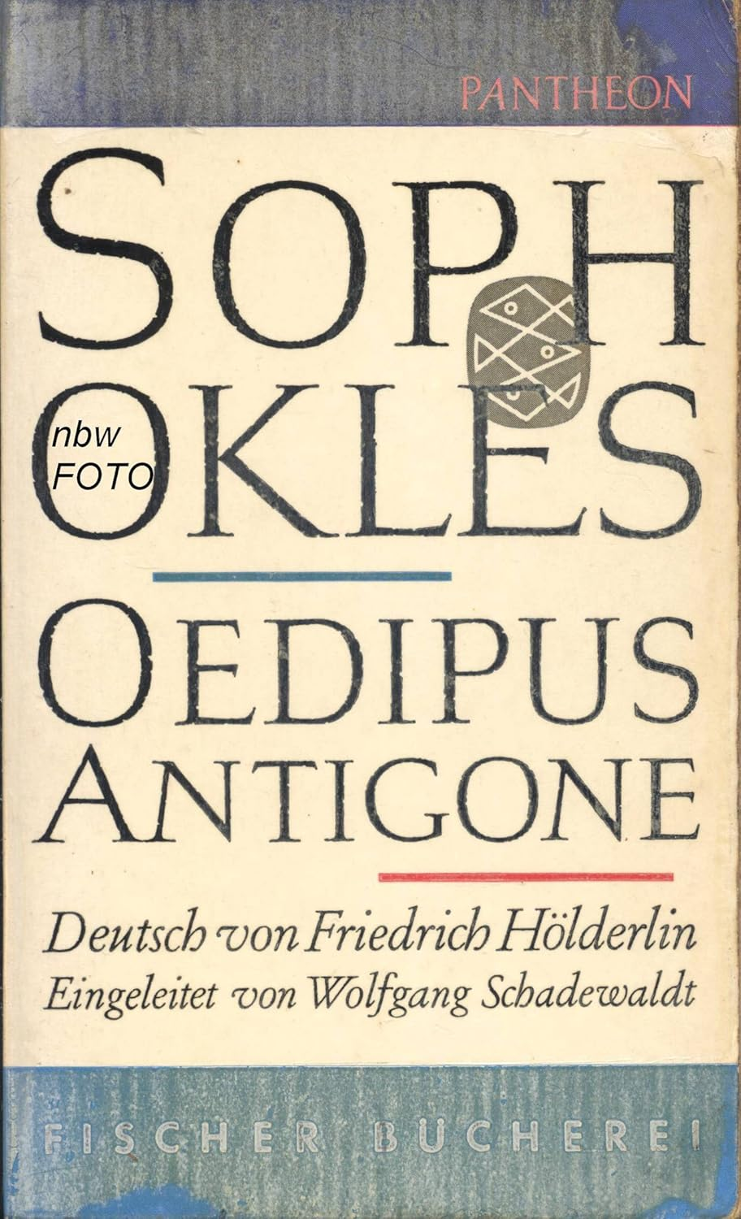
Antigone translation
Multiple interpretations
Helderlin translated Sophocles' Antigone in 1804 revives in the enlightened soul "the golden age of truth and beauty, Greece" Winkelmann: "we must imitate the Ancients in order to become inimitable in turn." Carl Reichart: "the highest poetry, apt to the end" Goethe: Helderlin's translations were derivatives of his insanity, the so-called Umnactung (plunge into darkness). Georg Steiner: verbal and editorial media are radicalized, with the result that external common discourse acquires internal cohesion of groups of metaphors and images, making the work the primary source of modernism... This translation was the basis of Hegel, when he calls Antigone "one of the highest and most complete... Artwork... ».

Slide 9
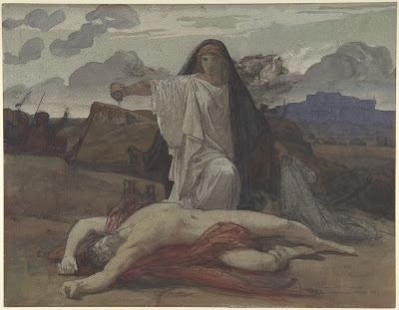
How Helderlin conveys the meaning of Sophocles' work and how he interprets the characters of Antigone and Creon and their conflict.
In an early period of classical idealism, the poet rendered the Greek original faithfully and freely, seeking to make the meaning of the Greeks clear in the German text. On a second level he translates literally, tapting the German language. On a third level, it embodies the human condition in a physical, political, and religious context. Translating literally, maintaining metre and respecting Greek prosody, he places emphasis on the political and religious interpretation of the work. The plot is faithful to the Sophoclean tragedy.

Slide 10
Time distance between Greece in the 5th century BC and Germany in the 19th century: teleological character the original from reflections of later years. Based on the contrast between Greek and Hesperium, he translates Sophocles, releasing his meanings and highlighting the spiritual needs of his time. Simeon Stampoulos: a kind of linguistic sin, hidden behind Sophocles' words that Henderlin "corrects", interpreting Napoleon's violent democratic discourse in Creon's dispute with his son Haemon in his own time. Antigone: revolutionary figure Helderlin's work: the tragedy of the transition from antiquity to modernity.

Slide 11
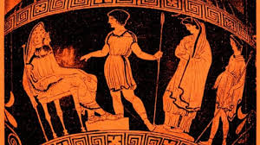
Hölderlin emphasizes more than Sophocles Antigone's struggle against a regime in the name of God. It elevates it to a symbol of resistance and a champion of democracy.
Antigone in front of Creon

Slide 12
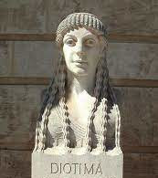

The poet identifies with his tragic heroes in their conflict with the gods and fate, their inevitable fall. His destiny is to experience precipitation and from there to pass into the inner light. The death of Diotima is a divine plan that tests him. Helderlin wants the teacher blind, as his role model, Homer, is to see insightfully. Writing Antigone, "struck by Apollo", he is led to blindness, Umnachtung, guided by the priestess Diotima.

Slide 13
We present some passages as an indication. We begin with the first ten verses of the Prologue.
Antigonä:
Gemeinsamschwesterliches, o Ismenes Haupt,
Weißt Du etwas, das nicht der Erde Vater
Erfuhr, mit uns, die wir bis hieher leben,
Ein Nennbares, seit Oedipus gehascht ward?
Nicht eine traur'ge Arbeit, auch kein Irrsaal,
Und schändlich ist, und ehrlos nirgend eines,
das ich in Deinem, meinem Unglük nicht gesehn.
Jetzt aber, ahnest du das, was der Feldherr
Uns kundgethan, in offner Stadt, so eben?
Hast du gehört es? oder weist du nicht,
Wie auf die Lieben kommet Feindesübel?»
ΑΝΤΙΓΟΝΗ Ὦ κοινὸν αὐτάδελφον Ἰσμήνης κάρα, ἆρ᾽ οἶσθ᾽ ὅ τι Ζεὺς τῶν ἀπ᾽ Οἰδίπου κακῶν ὁποῖον οὐχὶ νῷν ἔτι ζώσαιν τελεῖ; οὐδὲν γὰρ οὔτ᾽ ἀλγεινὸν οὔτ᾽ ἄτης ἄτερ οὔτ᾽ αἰσχρὸν οὔτ᾽ ἄτιμόν ἐσθ᾽, ὁποῖον οὐ τῶν σῶν τε κἀμῶν οὐκ ὄπωπ᾽ ἐγὼ κακῶν. καὶ νῦν τί τοῦτ᾽ αὖ φασι πανδήμῳ πόλει κήρυγμα θεῖναι τὸν στρατηγὸν ἀρτίως; ἔχεις τι κεἰσήκουσας; ἤ σε λανθάνει πρὸς τοὺς φίλους στείχοντα τῶν ἐχθρῶν κακά;
O my beloved sister Ismene, you know which of the evils Oedipus He left us a legacy, to stay that Zeus did not send to the two of us Where are we still alive? Because no pain and no curse, no shame and no dishonesty I didn't see him missing yours and by my own misfortunes. And now What is this command again, which they say? How come he trumpeted in the country And to all citizens our ruler? Do you know and hear anything? or you don't have news get how bad they are preparing For our beloved enemies?
Translated by Gryparis I.

Slide 14
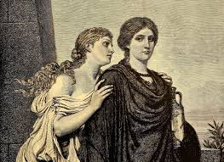
PROLOGOS col.45-47
ΑΝ. τὸν γοῦν ἐμὸν καὶ τὸν σόν, ἢν σὺ μὴ θέλῃς, ἀδελφόν· οὐ γὰρ δὴ προδοῦσ᾽ ἁλώσομαι. ΙΣ. ὦ σχετλία, Κρέοντος ἀντειρηκότος;
ANT. Yes, my brother and yours, if thou wilt not; because no one will say about me how I betrayed him. ISM. Unhappy, though Creon has prevented it;

Slide 15
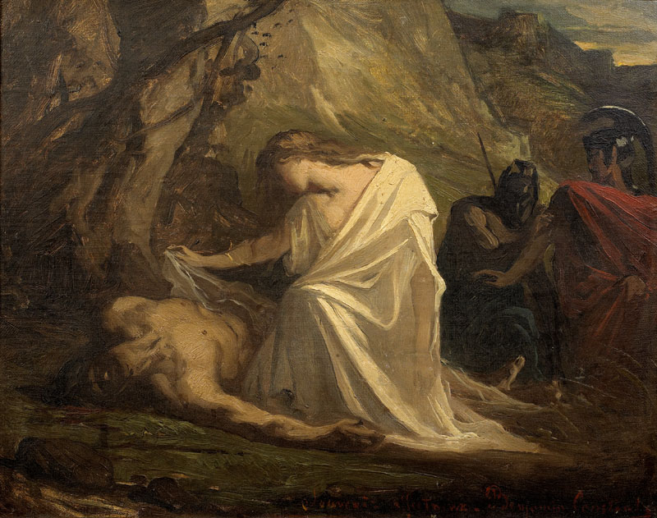
PROLOGOS col.73-74
φίλη μετ᾽ αὐτοῦ κείσομαι, φίλου μέτα, ὅσια πανουργήσασ᾽ ( With him, beloved, beloved, I will lie, for this holy pity of mine;)Lieb werd ich bei ihm liegen, bei dem Lieben(Full of love I will lie beside him, by the side of my beloved), wenn Heiligs ich vollbracht ( when in sanctity I will have fulfilled it)

Slide 16
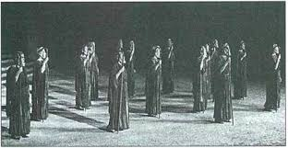
DANCE A Stationary
πολλὰ τὰ δεινὰ κοὐδὲν ἀν- θρώπου δεινότερον πέλει· τοῦτο καὶ πολιοῦ πέραν πόντου χειμερίῳ νότῳ χωρεῖ, περιβρυχίοισιν περῶν ὑπ᾽ οἴδμασιν, θεῶν τε τὰν ὑπερτάταν, Γᾶν ἄφθιτον, ἀκαμάταν, ἀποτρύεται, ἰλλομένων ἀρότρων ἔτος εἰς ἔτος,ἱππείῳ γένει πολεύων.
σοφόν τι τὸ μηχανόεν τέχνας ὑπὲρ ἐλπίδ᾽ ἔχων τοτὲ μὲν κακόν, ἄλλοτ᾽ ἐπ᾽ ἐσθλὸν ἕρπει. Laws of Pareiros chthonas God of the Sworn Trial Opsipolis;

Slide 17
EPISODE B v.449-457 Antigone admits her act to Creon
Kreon: Was wagtest du, ein solch Gesez zu brechen?
Antigonä: Darum. Mein Zeus berichtete mirs nicht; Noch hier im Haus das Recht der Todesgötter, Die unter Menschen das Gesez begränzet; Auch dacht' ich nicht, es sei dein Ausgebot so sehr viel, Daß eins, das sterben muß, die ungeschriebnen drüber Die festen Sazungen im Himmel brechen sollte. Nicht heut' und gestern nur, die leben immer, Und niemand weiß, woher sie sind gekommen.
ΚΡ. καὶ δῆτ᾽ ἐτόλμας τούσδ᾽ ὑπερβαίνειν νόμους; ΑΝ. οὐ γάρ τί μοι Ζεὺς ἦν ὁ κηρύξας τάδε, οὐδ᾽ ἡ ξύνοικος τῶν κάτω θεῶν Δίκη τοιούσδ᾽ ἐν ἀνθρώποισιν ὥρισεν νόμους, οὐδὲ σθένειν τοσοῦτον ᾠόμην τὰ σὰ κηρύγμαθ᾽ ὥστ᾽ ἄγραπτα κἀσφαλῆ θεῶν νόμιμα δύνασθαι θνητὸν ὄνθ᾽ ὑπερδραμεῖν. οὐ γάρ τι νῦν γε κἀχθές, ἀλλ᾽ ἀεί ποτε ζῇ ταῦτα, κοὐδεὶς οἶδεν ἐξ ὅτου ᾽φάνη.
CRE. So did you dare to transgress? this law? ANT. Yes, because it wasn't Zeus who had preached these things to me, Neither does the roommate with the gods of the Underworld, the Trial, these laws among men they ordained; and neither I believed so much power how to have your own sermons, till you are mortal to be able to laws of the gods the unwritten and unwavering to hurry; Why not today and yesterday, but eternally? They live, and no one knows it Since when did they appear?

Slide 18
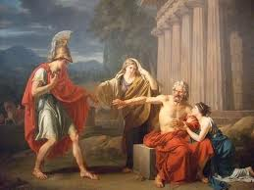
EPISODE C Dialogue between Creon and Haemon
ΚΡ. ἁμαρτάνω γὰρ τὰς ἐμὰς ἀρχὰς σέβων; ΑΙ. οὐ γὰρ σέβεις, τιμάς γε τὰς θεῶν πατῶν.
(CRE. Am I not right when I defend my office? AIM. You don't defend it, when you violate the laws of the gods)

Slide 19
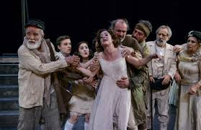
KOMMOS
Now I too betray my principles Seeing these things and not being strong the sources of tears to clog, as if I watched Antigone walk to the people's common cemetery. IF. O citizens of my fatherland, behold I walk the strata the sternum, the glow the sternum of the sun I see, and never before; Hades, the sleep of all, at Harou alive It takes me to the beach. Bride, I didn't dress up And they never sang a wedding dress at my door singing; bride in Haros next to me I will stand. ………………………………………

Slide 20
EPISODE B SCENE D New Lamentation of Antigone
O Grab! o Brautbett! unterirdische
Behausung, immerwach! Da werd’ ich reisen
Den Meinen zu (…)
(…)
(…) Doch komm’ ich an,
So nähr’ ich das mit Hoffnungen gar sehr,
Daß lieb ich kommen werde für den Vater,
Auch dir lieb, meine Mutter! lieb auch dir,
Du brüderliches Haupt! Denn als ihr starbt,
Hab’ ich genommen euch mit eigner Hand,
Und ausgeschmükt, und über eurem Grabe
Trankopfer euch gebracht
My burial, my bridal bed, my home in the deep earth and my eternal cell, I come to find my own dead whom a great crowd Persephone befriended. Stern and devastated I will go down, before I spend my life's share. Hope nourishes me that I will find your love, your love, mother, my eyes and my brother, your love. I, dead with my little hands, bathed you, decorated you, watered your grave with honey, milk and water; and now, Polynices, I pay dearly for your dead body. I have honoured thee, and the wise shall say how much; I would never carry such a burden against the city, if I were a mother with children, and if my husband rotted dead. What law moves me to say this?;

Slide 21
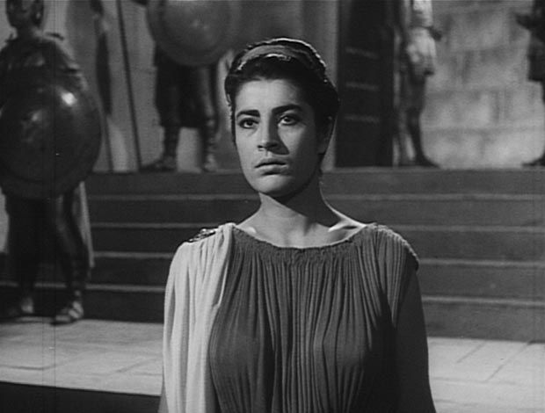
Respecting your time, we omitted the commentary of passages from the scene with the seer Tiresias, the last chorus with the presence of the god Dionysus, as well as the Exodus with the lament of Creon. We would like to believe that the relationship between Sophocles and Helderlin, the connection between classical Greece and 19th century Germany, the common elements that unite the two cultures, were understood. Thank you!
Irene Papa as Antigone

Slide 22

SOURCES
Steiner, George, The Antigones: the myth of Antigone in literature, arts and literature. thought of Hesperia, trans. Vasilis Mastoris - Paris Bourlakis, ed. Kalentis, Athens 20012' Puchner, Walter, "The translation of Sophocles' Antigone by Friedrich Hölderlin and the adaptation of Antigone by Bertolt Brecht. A literary detection". In Comparaison 10 (1999), pp.59-81. Republished in: Theatrum Mundi, Ten Theatrological Studies, ed. Ellinika Grammata, Athens 2000, pp. 243-269 Christoph Jamme , Hölderlin’s Theory of Tragedy Leuphana Universität Lüneburg file:///C:/Users/VASW/Downloads/admin,+1+-+JAMME+English+DIAGR.-4-2-1.pdf Antigone – Hölderlin Eine Widmung file:///C:/Users/VASW/Downloads/9783839400975-001-3.pdf SUSANNE GOTTLOB (verfasst Oktober 2007 ... was aber fehlet ... Antigona und die Frage nach dem Zusammenhang Dimitra Bock, The literary myth of Antigone in 20th century Europe, Master Erasmus Mundus enCultures Litteraires Europeennes – CLE (AUTH)https://www.greek-language.gr/digitalResources/ancient_greek/library/browse.html?page=5&text_id=76
https://users.sch.gr/ipap/Ellinikos%20Politismos/Yliko/ELENI/drama.htm
https://www.servou.gr/2013-06-23-10-30-27/grafipatrioton/319-philosophy/3137-antigoni-tou-sofokli-mathima-antistasis-stin-afthairesia-tis-eksousias-2
https://www.ime.gr/chronos/05/gr/culture/2314sophokles.html

Slide 23
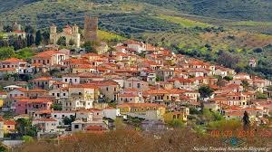
Thank you! The students of Avlonari High School
Avlonari Evia

